Slide 1


IO1- Spanish results
PARTNER MEETING: 3RD AND 4TH DECEMBER 2020

Slide 2
IO 1 - Stereotypes analysis and good practices to break them down
What the project foresees…. | Front Activities carried out | Products/number
Questionnaire for the survey | Number of on line and “live” meeting | Numbers of questionnaire
Survey among students | 4 “live” meetings | Numbers of questionnaire: 34
Survey among educators | 2 online and 2 “live” meetings | Numbers of questionnaires: 17
Survey among parents (optional) | Number of on line and “live” meetings: 0 | Numbers of questionnaires: 0

Slide 3
IO 1 - Stereotypes analysis and good practices to break them down
Methodology of the survey and solutions adopted (facing pandemic period)
The methodology changed because of Covid-19 with the closure of schools. 1st online attempt = Low response rate.
2nd attempt= Reopening of schools in September. 2 Vocational Training Centres answered positively.
2 face-to-face sessions with students and teachers. Duration of 1 -2 hours + Separate meetings with co-educators and tutors.
No participation of students' parents has been achieved. Vocational Training centres no close collaboration with parents.

Slide 4
IO 1 - Stereotypes analysis and good practices to break them down
General results of survey
The training sessions were carried out in a basic vocational training center (age 16-18) and a intermediate vocational center (age 19-30).
Important = both classes the majority of students were male+ 2 girls
Great difference between both classes: Age factor = very relevant in giving these answers. Youngest = More sexist that older students.

Slide 5
IO 1 - Stereotypes analysis and good practices to break them down
What kind of stereotypes comes from the survey?
CENTER 1:
2 sessions:
  ½ hours
  Middle Vocational Training
  Participants= All boys + one girl + teachers
I SESSION:
  Presentation of INCOMA and UP & UP project
  Filling in the online questionnaire
  Training session about stereotypes and gender violence + group activity
II SESSION:
  Short summary 1° meeting + a group activity on gender stereotypes.
  Debate: necessity of womens to wear certain clothes / physical capacity of each individual in carrying out domestic activities.
  Presentation of the results: Men are more likely to take science subjects/Women are more likely than men to make decisions based on their emotions/ Beauty (being attractive) is more important for a girl than for a boy.
  Section about personal relationships: The four most voted statements: Being understood, Loyalty, Respect for others, Mutual understanding.
  Debate among students and teachers + sharing students’ experiences + opinions.

Slide 6
IO 1 - Stereotypes analysis and good practices to break them down
CENTER 2:
2 sessions:
  ½ hours
  Basic Vocational Training
  Participants= All boys + one girl + teachers
I SESSION:
  Presentation of INCOMA and UP & UP project
  Filling in the online questionnaire
  Training session about stereotypes and gender violence + group activity
  A debate about gender violence and why a law is needed

Slide 7
IO 1 - Stereotypes analysis and good practices to break them down
CENTER 2:
II SESSION:
  Short summary of the 1° meeting + a group activity
  Presentation of the results: Women are afraid to take on big responsibilities/ Women are better prepared to raise children than men/ Women are more likely than men to make decisions based on their emotions.
  Analyzing results several stereotypical reasoning emerged:
    The fear of making big decisions can be found in both men and women.
    Women are by nature more prepared to raise children
    Making decisions based on emotions can be male or female / Women are more emotional and aggressive than men.
  Section about personal relationships: Solidarity/Knowing how to always respond to the needs of the other/ Respect for others/Sexual understanding
  Almost all the results were around 3 (Neutral). We therefore thought that students did not identify with any of these values.
  Debate was created asking new opinions: Laughing together/Empathy/A non toxic realtionship/Admiration.

Slide 8
IO 1 - Stereotypes analysis and good practices to break them down
What is the level of acceptability of gender based violence from the questions?
Acceptance of sexist statements from the questionnaire:
  Centre 1: the sexist beliefs were worse valued. Not possible to conclude if their answers were based on "social desirability" or on truly personal criteria. Results = NO sexist
  Centre 2: the acceptance of the statements was much higher, not positioning themselves in support of neither against the statements. Given the sexist nature of the statements. Results = sexist
Students’ opinion about the concept of "gender violence”:
  Centre 1: did not show agreement or disagreement with the concept. Exception: 1 student was against the terminology feminism.
  Centre 2: the resistance was clear. Several students used typical examples to defend the irrelevance of Gender violence law: "What if my girlfriend hits me, it's okay", "There are a lot of false allegations because of this law”

Slide 9
IO 1 - Stereotypes analysis and good practices to break them down
What is the educators’ opinion about their students?
The results 1st section: tendency to value the students' opinion as more sexist. Although teachers show a clear rejection of sexist or gender stereotyped statements. Consider the students to have ingrained sexist beliefs.
The results 2nd section: in a very slight way teachers consider that for students (more accentuated for boys) physical aspects + sexuality = relevant in their relationships. But students’ results did not show this in a clear way.

Slide 10
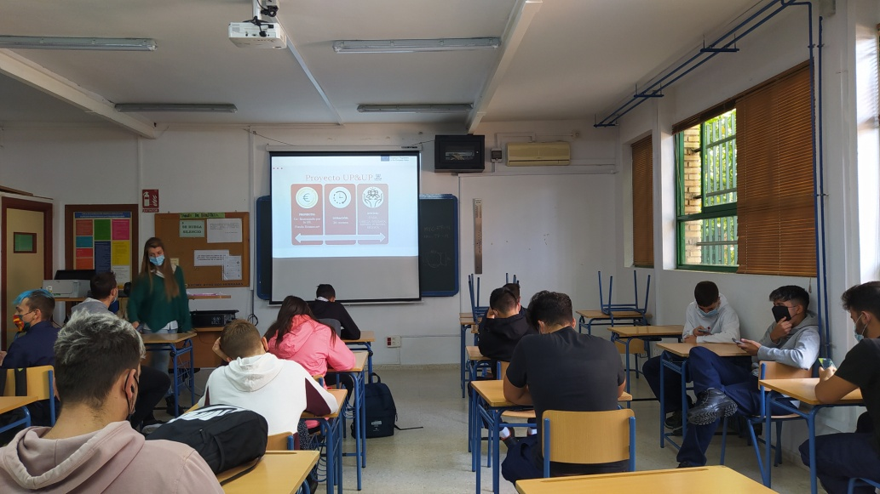
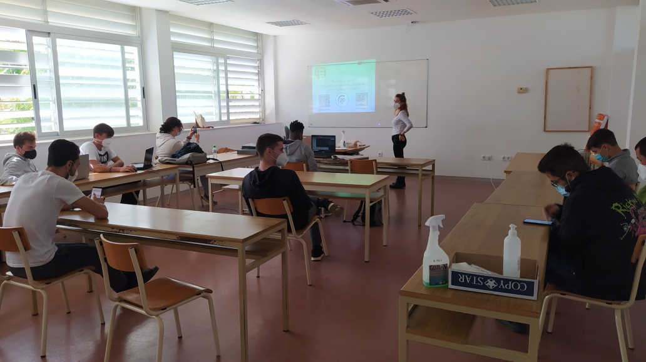
IO 1 - Stereotypes analysis and good practices to break them down
Pictures and screenshots

Slide 11
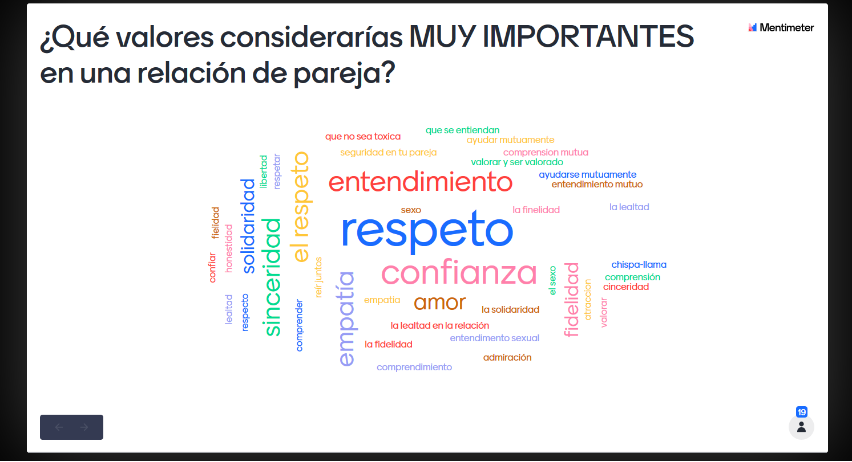
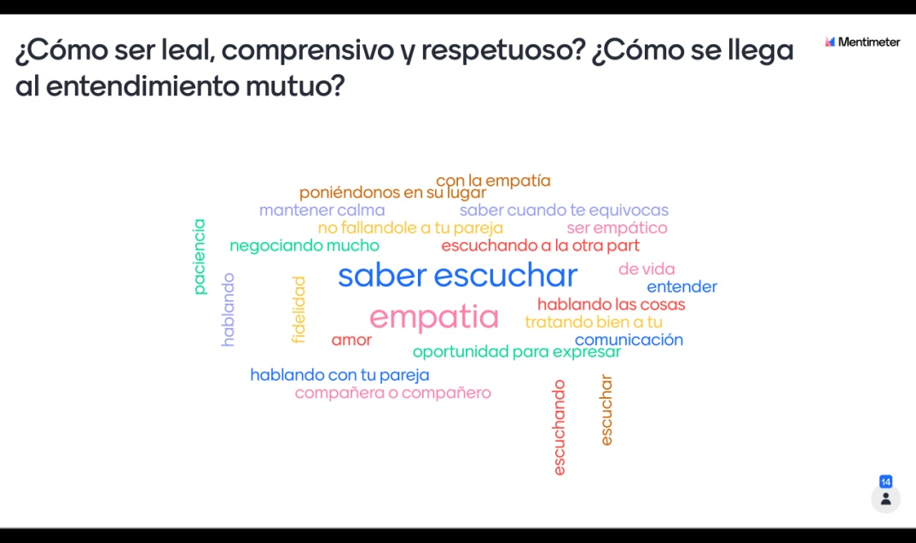
IO 1 - Stereotypes analysis and good practices to break them down
Pictures and screenshots

Slide 12
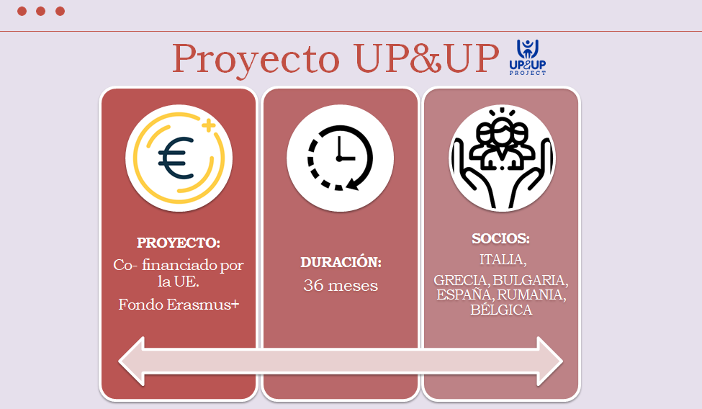
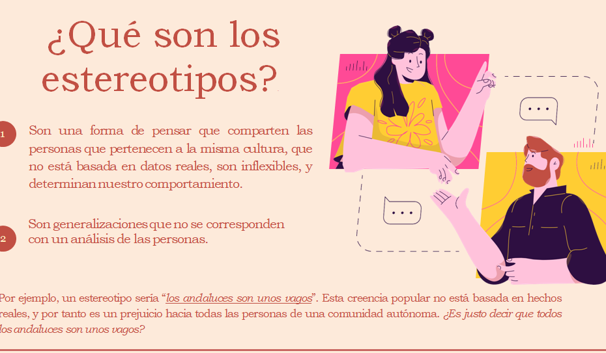
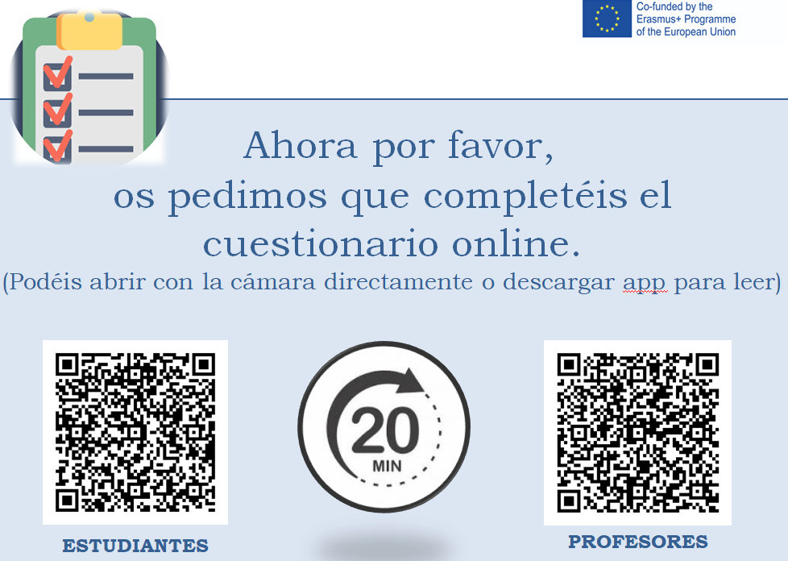
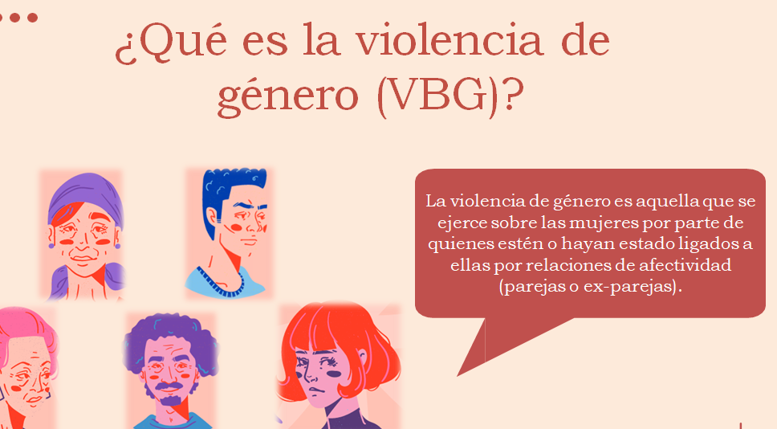
IO 1 - Stereotypes analysis and good practices to break them down
Pictures and screenshots

Slide 13
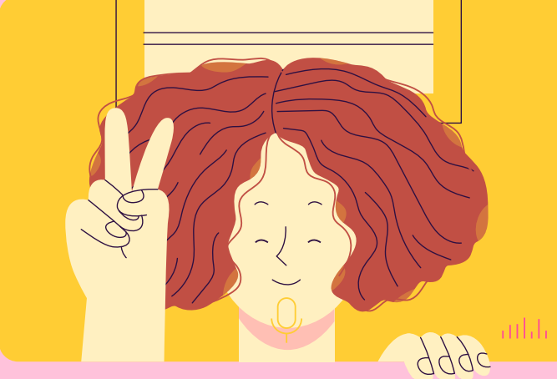
Thank you for listening!

