Slide 1
Welcome to the workshop!
DOUBLE TAP FOR GENDER AWARENESS: SOCIAL MEDIA’S ROLE IN SHAPING YOUTH VIEWS ON GENDER STEREOTYPES AND GENDER-BASED VIOLENCE
This session is part of the UP&UP FOR DIGITAL SOCIETY (UP&UP4DS) project, funded by Erasmus+, work package #2 focusing on online content analysis and breaking down gender stereotypes.

Slide 2
A deeper understanding of how social media shapes perceptions of gender and violence
3 key takeaways from today's session
The ability to recognize gender stereotypes and various forms of cyber violence
The development of a critical mindset towards online content

Slide 3
Confidentiality:
What’s discussed here, stays here
Some simple rules for a safe space
Mutual respect:
We listen actively to one another, without judgment
We learn together:
Ask questions by raising your hand

Slide 4
2
1
Mood
Barometer
3
What animal best represents your mood right now?
4
5

Slide 5
What curiosities or questions do you have about today’s workshop topic?
Grab a post-it and feel free to write down a question or something you'd like to explore during our session today.

Slide 6
Interactive exercise:
explaining life on earth to friendly aliens

Slide 7
Let’s talk about
gender stereotypes!
...imaginary boxes where we place men and women, with preset ideas about how they should be
women
men

Slide 8
Why talk
about this
When people are forced into boxes, it limits their ability to reach their full potential. Every person is unique and complex and deserves to be respected for who they truly are.
That's why we talk about it!

Slide 9
gender stereotypes
and gender norms
social pressure - people feel pressured to conform to these norms to be accepted or avoid criticism
"Boys should be
strong and never cry"
A boy who cries in public might be told
The boy may feel like he has to hide his feelings or act tough so that his friends don’t judge him.
"Stop crying, you're acting like a girl!"
The cycle repeats, making it harder for him to break free
cyberviolence: In the online world, these gender stereotypes and pressures can lead to online bullying or harassment.
Gender-Based Violence (GBV): when someone doesn’t follow these norms, they may face violence
The boy may be targeted in online comments for being "too soft" or for showing his emotions, with people calling him "weak" or "girly"
The boy might be bullied, pushed, or insulted for not acting "manly" enough, and told to "stop being weak."

Slide 10
8 forms of cyber violence
cyber harassment & bullying
online
hate speech
cyber stalking
revenge porn
When someone repeatedly tracks or harasses you online, making you feel unsafe.
For example, your ex secretly uses a location-sharing app to monitor where you go without your consent.
When someone repeatedly attacks or humiliates you online.
For example, after you post a selfie, a group of people starts sending you hateful messages and making fun of you in the comments.
When someone spreads violent or sexist messages targeting you.
For example, you share your opinion on gender equality, and strangers flood your DMs with threats and misogynistic insults.
When someone shares your private photos or videos without consent.
For example, you send a private photo to someone you trust, but later they threaten to leak it unless you send more.(sextortion).
IoT-facilitated violence
doxing
grooming
trolling
When someone shares your private details online, putting you at risk.
For example, after you criticize an influencer, your phone number and home address get posted online, and strangers start harassing you.
When an adult manipulates you into sharing explicit content.
For example, you meet someone online who says they’re your age, but over time, they pressure you to send personal photos.
When people deliberately insult or provoke you online.
For example, you’re streaming a game and random users start spamming sexist comments to make you feel unwelcome.
When someone hacks your smart devices to harass or control you.
For example, your home security camera suddenly moves on its own, and you realize someone is watching you without permission.

Slide 11
low self-esteem: victims may feel insecure and helpless
Effects of cyber violence
mental health issues: depression & anxiety, isolation, avoiding school, or social interactions, including PTSD
fear of using the internet: threats and hurtful comments may make people hesitant to post or engage online again
self-censoring due to online abuse
struggling in school due to withdrawal and difficulty concentrating, stress.

Slide 12
block & report: block the person harassing you and leave the conversation or platform. Use privacy settings to protect your personal information and report harmful content
what do
we
do
remember you’re not alone: Talk to someone you trust—whether it’s a close friend or an adult. Many have been through similar experiences and can guide you. If it’s a classmate, speak with your teacher or counselor
gather evidence: take screenshots of messages, comments, or posts. Record any interactions that can prove you’re being harassed

Slide 13
find others affected: if the person bullying you is targeting others, connect with them. Shared evidence can strengthen your case
what do
we
do
contact authorities: if the bullying continues, report it. Social media platforms have reporting tools, and local authorities can help in serious cases (e.g., threats, online blackmail)
very important: don’t minimise your experience! cyber violence’s effects can be serious and long-lasting. Don’t ignore what you’re feeling. Speak out and take action!

Slide 14
Let’s talk about
social media

Slide 15
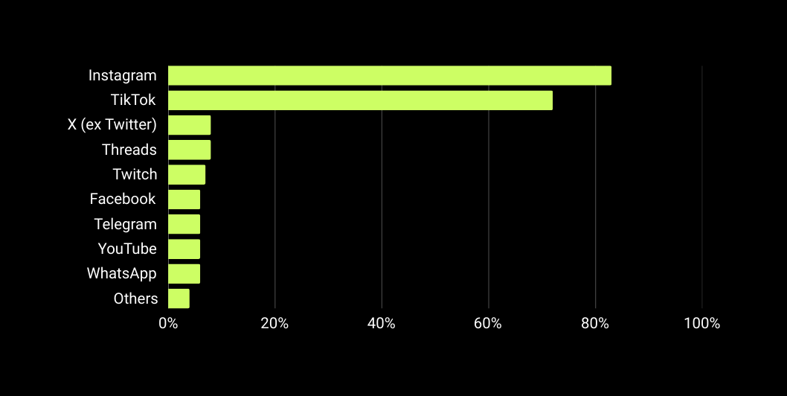
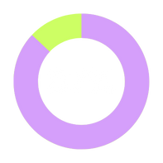
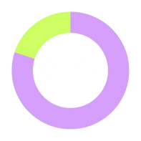
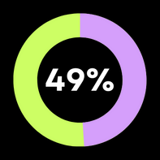
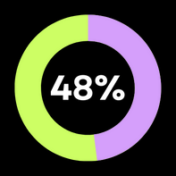
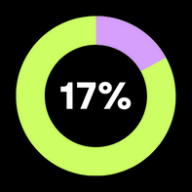
You are highly engaged with Instagram and TikTok, favouring memes (87%) and video content (80%).
memes
videos
posts
photos
articles

Slide 16
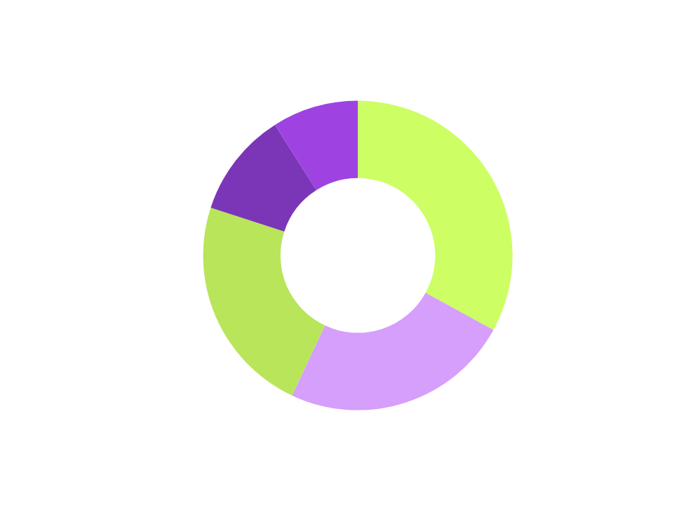
SoMe doesn’t have a one-size-fits-all impact
Most of you feel social media’s impact is either limited (33%) or moderate (23%)

Slide 17
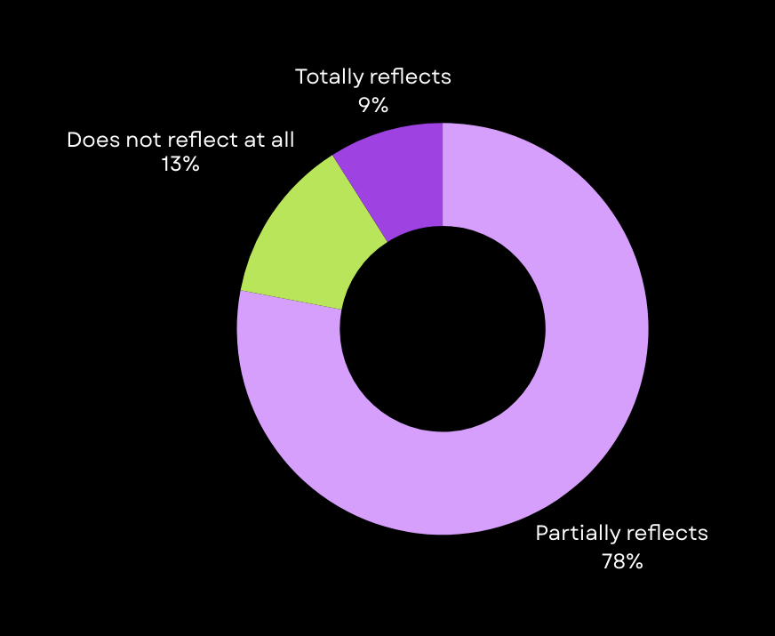
Most of you (78%) agree that social media doesn’t fully show real life or diversity, seeing it as more of a curated, idealised version.

Slide 18
87% of you follow influencers
...and 69% are active on social media every single day!

Slide 19
Have you ever stopped to think that some of the info we get online from influencers and trending topics might actually be problematic?

Slide 20
influencers may reinforce traditional gender roles, like the idea that men should always be the "providers" or women should handle the domestic duties - see the tradwives trend
some influencers, particularly in fitness or lifestyle spaces, might promote toxic masculinity, encouraging men to suppress emotions, be aggressive, or avoid vulnerability - see Andrew Tate
actual examples
the "girl math" trend, where women justify spending money or making decisions based on overly simplistic or humorous logic
"masculine" and "feminine" energies - posts might claim that men should embody "action, logic, and strength" (masculine energy) while women should focus on "intuition, nurturing, and softness" (feminine energy)
"perfect couple" image - many influencers portray an idealised, flawless relationship dynamic and his can create pressure to conform to these ideals and ignore the complexity of a relationship

Slide 21
How do the posts and messages we see daily influence us, and how do they change the way we perceive ourselves and those around us

Slide 22
We need more influencers to speak out on harassment, body shaming, and online abuse. They can help challenge harmful stereotypes and create positive change.
what needs to change
Schools must teach students how to recognise and challenge gender stereotypes and GBV.
Online platforms must make it easier for us to report abuse and block harmful content or accounts.
Policymakers need to develop and enforce rules that address online violence and discrimination.
We need accessible resources and support for those experiencing online abuse, especially gender-based violence, so that they don’t feel alone.

Slide 23
We've made it to the finish line.
Are you feeling more ready now?

Slide 24
a biiiiiiiig thank you!
please don't forget to fill out the feedback form

